Slide 1

STOCK PRICE PREDICTION USING LSTM
Presented by
CHEKKA VVSN MANIKUMAR
(19A91F0004)
Internal Guide:
K C P PRADEEP

Slide 2
CONTENTS
Abstract
Existing system and Disadvantages
Proposed system and Advantages
System Architecture
Proposed Algorithm
Functional Requirements
System Requirements
Modules
UML Diagrams
Screen shots
Conclusion

Slide 3
ABSTRACT
Stock price is an unpredictable curve. Prediction in stock market is covered with the complexity and instability. The main aim for the topic is to predict the stability in the future market stocks. Many researchers have performed their research on the movement of future market evolution. Stock consists of fluctuating data which makes data as an integral source of efficiency. Impact on the same chances the efficiency of the prediction. In the recent trend of Stock Market Prediction Technologies machine learning has integrated itself in the picture for deployment and prediction of training sets and data models. Machine Learning has different predictive models and algorithms to predict and automate things of requirement. We are applying a LSTM approach for predicting future values on a short term basis.

Slide 4
EXISTING SYSTEM
As many have invested their time and effort in this world trade for getting it closer and more reliable to the people for carrying out the resources and make their lifestyle more than the previous.
The existing models can’t cope up with the burden and remove the rarest information that they can’t process causing it a major data loss which creates a problem in forecasting.
Observation is the integral part in the resource and prediction management.
Loss of sights is a major problem in the existing system as the stock varies each days and the loss margin can be higher with respect to time. An initial instance is taken for prediction.

Slide 5
Disadvantages:
The existing system fails when there are rare outcomes or predictors, as the algorithm is based on bootstrap sampling.
The previous results indicate that the stock price is unpredictable when the traditional classifier is used.
The existence system reported highly predictive values, by selecting an appropriate time period for their experiment to obtain highly predictive scores.

Slide 6
PROPOSED SYSTEM
In this proposed system, we focus on predicting the stock values using machine learning algorithms like Long-Short Term Memory (LSTM).
In this proposed system, we were able to train the machine from the various data points from the past to make a future prediction.
We took data from the previous year stocks to train the model. We majorly used teo machine-learning libraries to solve the problem.
The first one was numpy , which was used to clean and manipulate the data, and getting it into a form ready for analysis. The other was sklearn, which was used for real analysis and prediction. The data set we used was from the previous years stock markets collected from the public database available online, 80 % of data was used to train the machine and the rest 20 % to test the data.

Slide 7
Advantages:
We used the python pandas library for data processing which combined different datasets into a data frame.
The data frame features were date and the closing price for a particular day.
We used all these features to train the machine on LSTM and predicted the object variable, which is the price for a given day.
We also quantified the accuracy by using the predictions for the test set and the actual values.

Slide 8
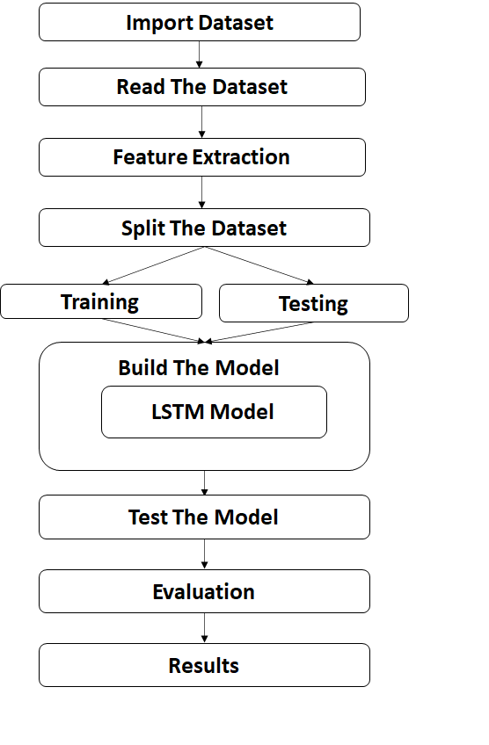
SYSTEM ARCHITECTURE

Slide 9
System Architecture Description:
The system architecture has following steps:
Import Necessary Packages.
Read the Dataset.
Exploratory Data Analysis i.e. finding null values, duplicate values etc.
Selecting Features (X) and Target (y) columns.
Train Test Split will split the whole dataset into train and test data.
Build the model i.e. Training the model.
Test the model i.e. Model prediction.
Evaluation of the system i.e. Accuracy score.

Slide 10
PROPOSED ALGORITHM
Algorithm: Long Short Term Memory Network (LSTM)
LSTM is a special kind of Recurrent Neural Network. These recurrent unit tries to remember all the past knowledge that the network is seen so far and to forget irrelevant data. LSTM has feedback connections, i.e., it is capable of processing the entire sequence of data. Each LSTM recurrent unit also maintains a vector called the Internal Cell State which conceptually describes the information that was chosen to be retained by the previous LSTM recurrent unit. LSTM is a special kind of RNN, which shows outstanding performance on a large variety of problems.
The LSTM algorithm is well adapted to categorize, analyze and predict time series of uncertain duration.
The LSTM can delete or add information to the cell state, which is carefully controlled by structures called gates.

Slide 11
A Long Short Term Memory Network consists of different gates for different purposes as described below: Forget Gate: It determines the extent of information be written onto the internal cell state. The cell tries to learn new information from the input to this cell. Input Gate: It determines to what extent to forget the previous data that means, whether the information coming from the previous timestamp is to be remembered or is irrelevant and can be forgotten. Output Gate: It determines what output (next hidden state) to generate from the current Internal cell state. This cell passes the updated information from the current timestamp to the next timestamp

Slide 12
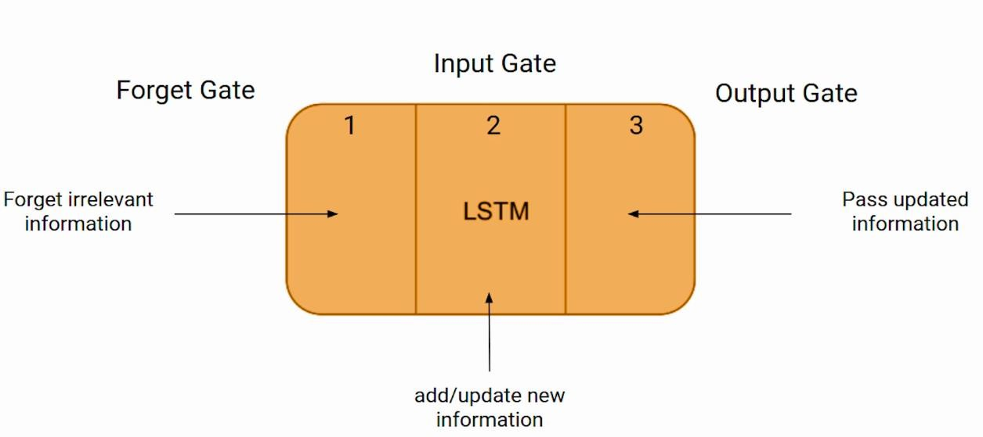
1.In the first step, LSTM is to decide how much of the past it should remember which information to be omitted in from the cell in that particular time step. It looks at the previous state and the current input and computes the function. 2.In the second step, It decides how much should this unit add to the current state. It takes the sufficient data and ignores the irrelevant data. 3.In the Third step, It decides what part of the current cell state makes it to the output. The task of extracting useful information from the current cell state to be presented as output.

Slide 13
FUNCTIONAL REQUIREMENTS
The functional requirements describe the core functionality of the software. It specifies the parameters of the project.
The model shall accept the open price and close price of the day and also accept the high price and low price of the day as a input.
The model should shall do pre-processing (like verifying for missing data values) on input for model training.
The model shall use LSTM algorithm as main component of the software.
It processes the given input data by producing the most possible outcomes of a open and close prices of the stock.

Slide 14
System Requirements Specifications
Software Requirements :
Operating System : Windows 11
Technologies : Python
Tools : Jupyter Notebook
Minimum Hardware Requirements :
RAM : 8 GB
Hard Disk : 512 GB
Processor : Intel Core i5

Slide 15
MODULES

Slide 16
Modules Description
Data Collection: Data used in my project is a set of prices on a company collected from a given dataset records. This step is concerned with selecting the subset of all available data that you will be working with. ML problems start with data preferably, lots of data (examples or observations) for which you already know the target answer. Data for which you already know the target answer is called labelled data.
Data Pre-processing: Organize your selected data by formatting, cleaning and sampling from it. Three common data pre-processing steps are:
Formatting: The data you have selected may not be in a format that is suitable for you to work with. The data may be in a relational database and you would like it in a flat file, or the data may be in a proprietary file format and you would like it in a relational database or a text file.
Cleaning: Cleaning data is the removal or fixing of missing data. There may be data instances that are incomplete and do not carry the data you believe you need to address the problem. These instances may need to be removed. Additionally, there may be Stock Price Prediciton Using LSTM 14 sensitive information in some of the attributes and these attributes may need to be removed from the data entirely.
Sampling: There may be far more selected data available than you need to work with. More data can result in much longer running times for algorithms and larger computational and memory requirements. You can take a smaller representative sample of the selected data that may be much faster for exploring and prototyping solutions before considering the whole dataset.

Slide 17
Feature Extraction: Feature extraction is an attribute reduction process. Unlike feature selection, which ranks the existing attributes according to their predictive significance, feature extraction actually transforms the attributes. The transformed attributes, or features, are linear combinations of the original attributes. Finally, our models are trained using classifier algorithm. The module is classified on Natural Language Toolkit library in Python. The labelled data gathered and rest of the labelled data will be used to evaluate the models.
Model Evaluation: Model Evaluation is an integral part of the model development process. It helpsto find the best model that represents our data and how well the chosen model will work in the future. Evaluating model performance with the data used for training is not acceptable in data science because it can easily generate overoptimistic and over fitted models. To avoid over fitting, both methods use a test set (not seen by the model) to evaluate model performance. Performance of each classification model is estimated base on its averaged. The result will be in the visualized form.
Accuracy Score: Accuracy is used to evaluate the number of True positives. Higher the number of True Positives, accurate the model is. Sometimes Accuracy metrics can be misleading when the dataset is highly imbalanced the true positive will be high for the higher instance class.

Slide 18
UML DIAGRAMS

Slide 19
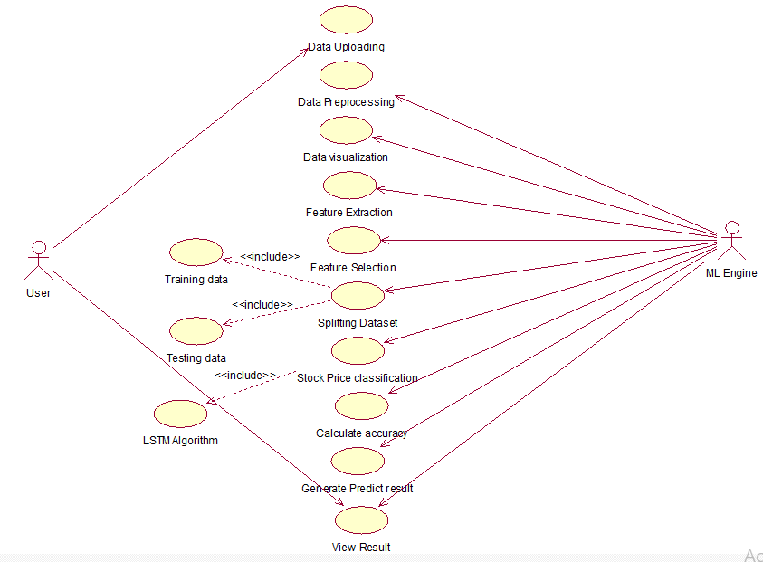
USE CASE DIAGRAM

Slide 20
Use case Templates:
Use Case Name | Data Upload
Participating Actors | User
Flow Of Events | It will load the load from the selected path where it is located in the system.
Entry Condition | User has to upload the data.
Exit Condition | Data upload successfully.
Use Case Name | Data Pre-processing
Participating Actors | User
Flow Of Events | It is subpart of data pre-processing some of the operations applied to handle unnecessary data like duplicates, outliers and missing values.
Entry Condition | The file consists of features.
Exit Condition | The features are successfully generated.

Slide 21
Use Case Name | Data Visualization
Participating Actors | User
Flow Of Events | It is subpart of data pre-processing some of the operations applied to visualize the data in the form of graphs.
Entry Condition | The file consists of features.
Exit Condition | The features are successfully generated.
Use Case Name | Feature Extraction
Participating Actors | User
Flow Of Events | It is a process of transforming raw data into numerical features that can be processed while preserving the information in the original data set.
Entry Condition | Then the numerical input has been taken.
Exit Condition | It will Successful gives the result.

Slide 22
Use Case Name | Feature Selection
Participating Actors | User
Flow Of Events | It is a process of reducing the number of input variables when developing a predictive model.
Entry Condition | Then the input variables had been reduced.
Exit Condition | It will Successful gives the result.
Use Case Name | Splitting dataset
Participating Actors | User
Flow Of Events | It is a process of splitting a dataset into training and testing in the ratio of 8:2
Entry Condition | Load the data Trained dataset.
Exit Condition | The data will train the training dataset.

Slide 23
Use Case Name | Perform Classification
Participating Actors | User, ML Engine
Flow Of Events | It models the class with the features.
Entry Condition | It takes the input from the data instances.
Exit Condition | It generates the results from each class.
Use Case Name | Calculate Accuracy
Participating Actors | User, ML Engine
Flow Of Events | Model may give you satisfying results when evaluated. Evaluation metrics LSTM as name suggests gives us output and describes the complete detection of model.
Entry Condition | Accuracy can be calculated.
Exit Condition | The accuracy evaluated.

Slide 24
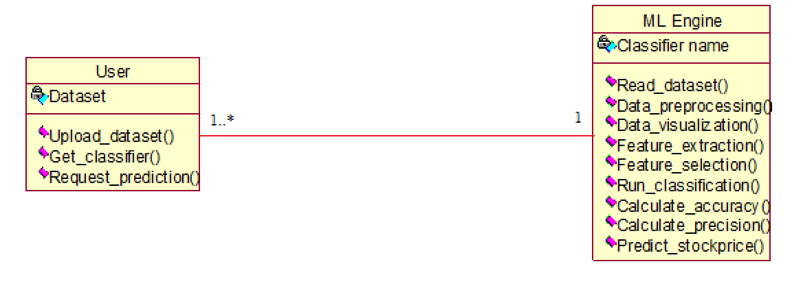
CLASS DIAGRAM

Slide 25
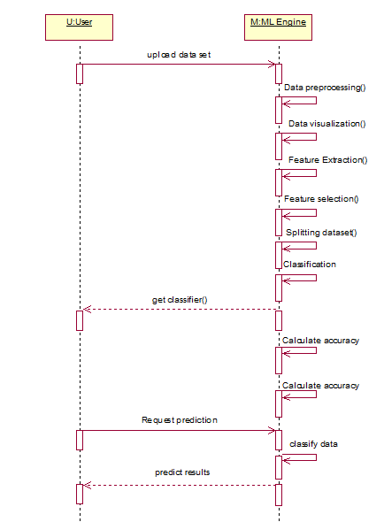
SEQUENCE DIAGRAM

Slide 26
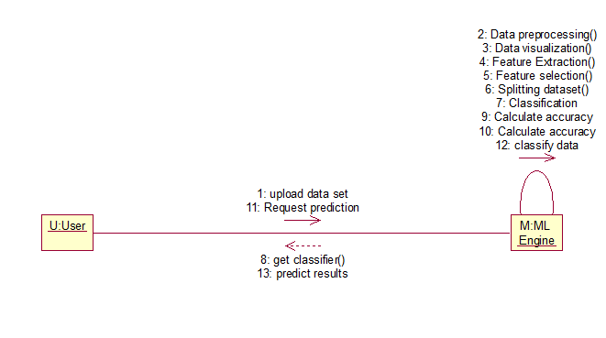
COLLABORATION DIAGRAM

Slide 27
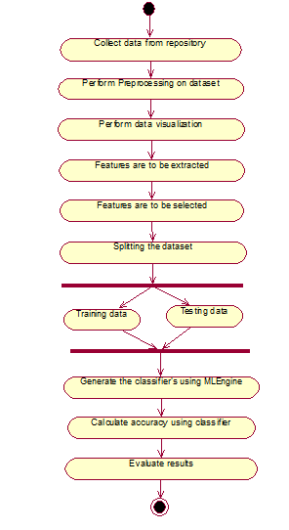
ACTIVITY DIAGRAM

Slide 28
SCREEN SHOTS

Slide 29
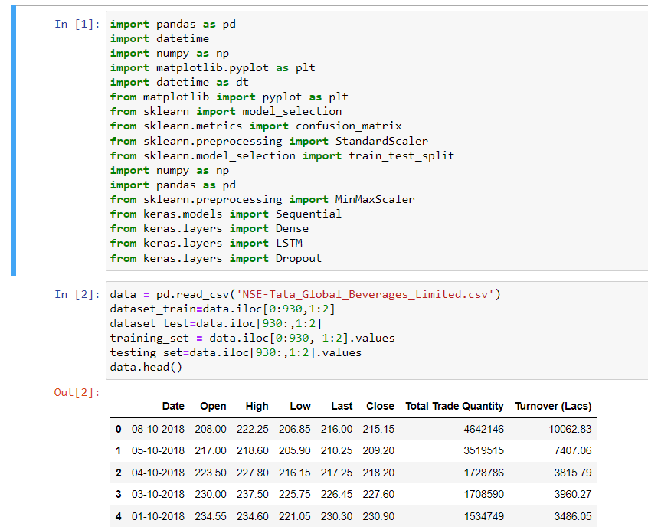
Screenshot for importing the necessary packages, loading the dataset and displaying the head of the dataset

Slide 30
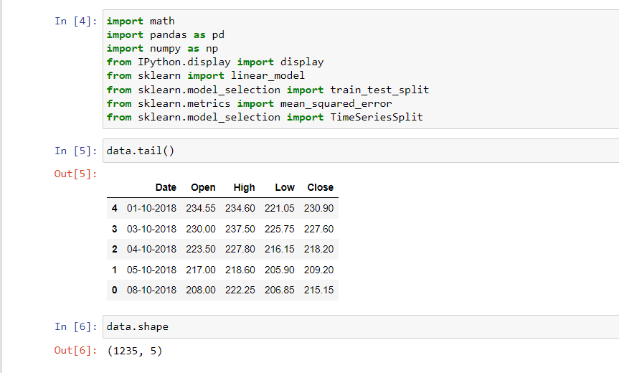
Screenshot for displaying the tail of the dataset and the shape of the dataset

Slide 31
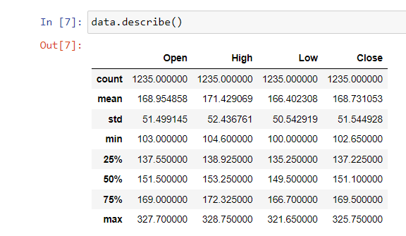
Screenshot for describing the dataset

Slide 32
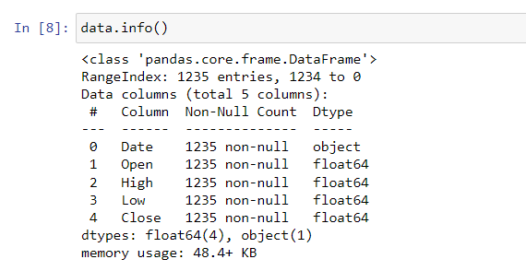
Screenshot for the summary of the dataset

Slide 33
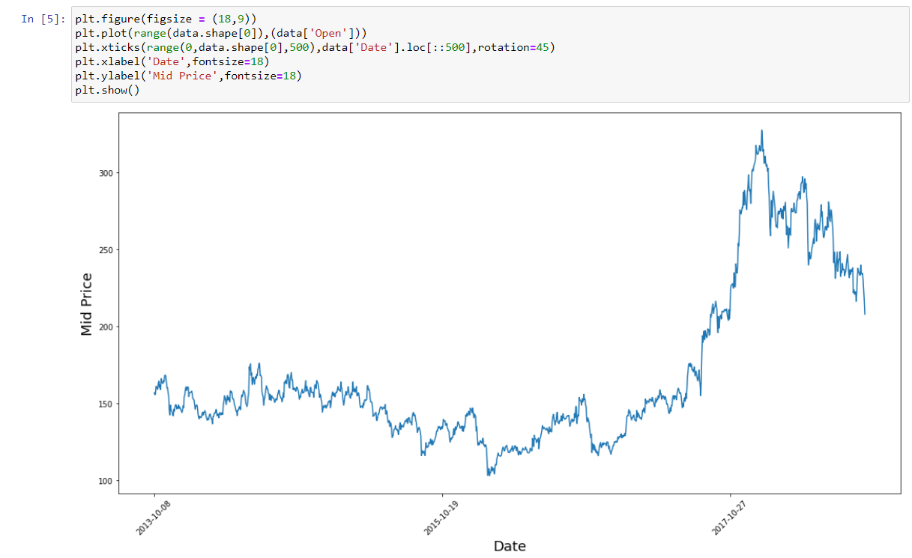
Screenshot for Ploting the dataset into graph taking from date & MidPrice

Slide 34
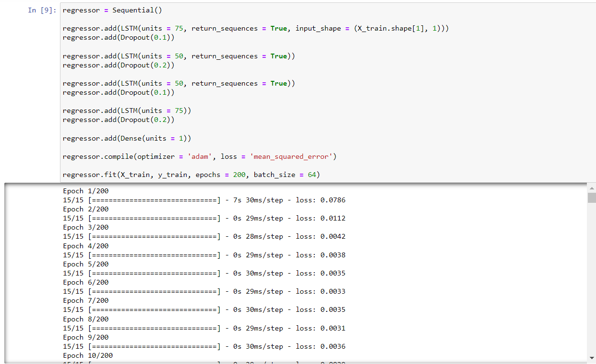
Screenshot for performing LSTM Algorithm

Slide 35
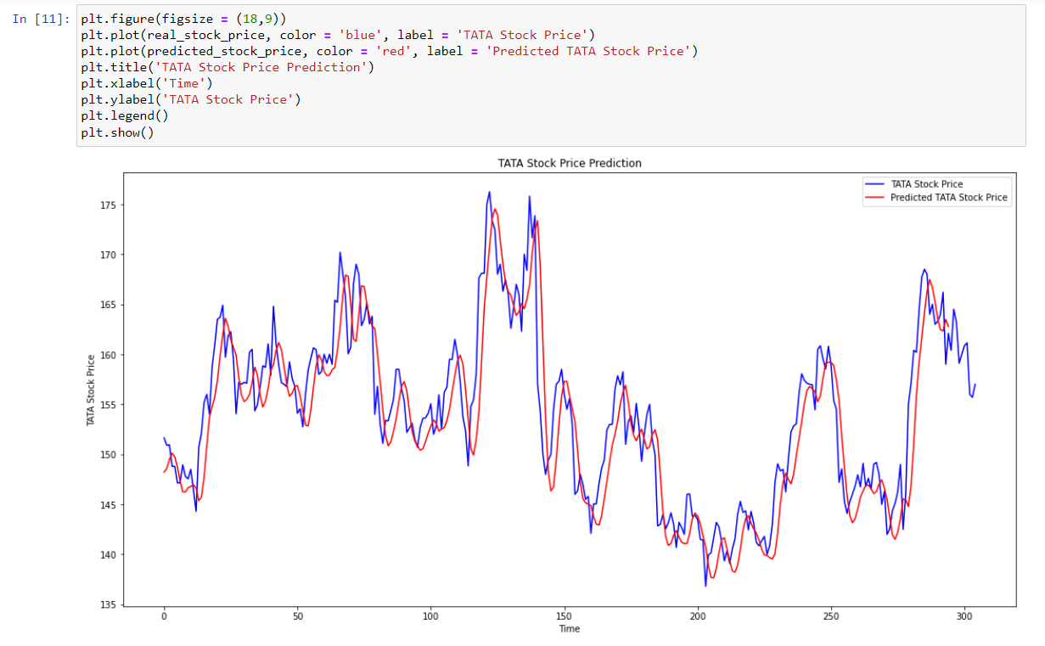
Screenshot for testing and plotting the dataset using xlabel as time and ylabel as stock price

Slide 36
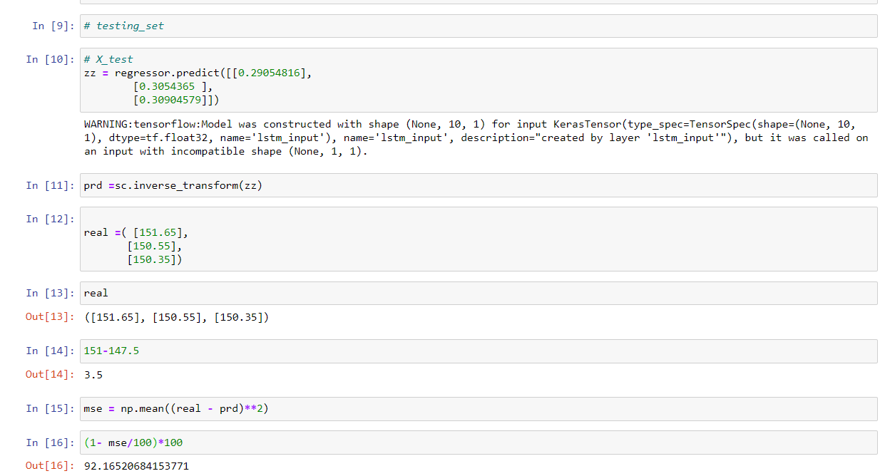
Screenshot for testing the closing stock price

Slide 37
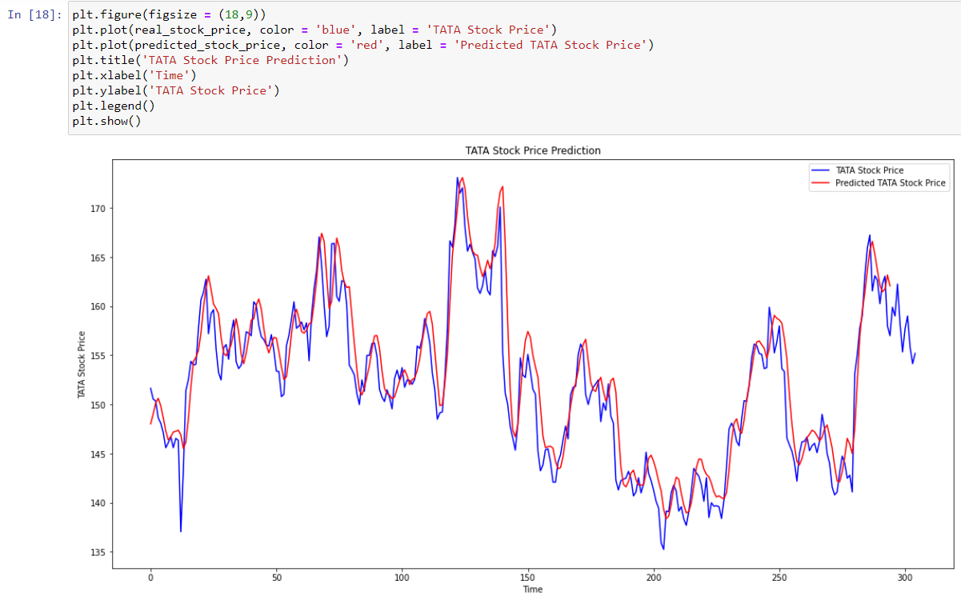
Screenshot for plotting the predicted price and old data price

Slide 38
CONCLUSION
Evaluating the Stock market prediction has at all times been tough work for analysis. The attempt to make of written data to forecast the stock market indices. If we join both techniques of textual mining and numeric time series analysis the accuracy in predictions can be achieved. Artificial neural network is qualified to forecast BSE/NSE market upcoming trends. Financial analysts, investors can use this prediction model to take trading decision by observing market behaviour.
The future scope of the project work on refining key phrases extraction will definitely produce better results. Enhancements in the pre processor unit of this system will help in improving more accurate predictability in stock market.
-Twitter feeds message board, Extracting RSS feeds and news.
- Considering internal factors of the company likes Sales, Assets etc.

Slide 39
THANK YOU

